Slide 1
Short Course in Linguistics
Intro to Phonetics

Slide 2
Aims
Introduction to some of the core principles of:
Linguistics
Computational Linguistics

Slide 3
Topics
Phonetics and Phonology
Morphology
Syntax
Semantics
Identity

Slide 4
Some recurring themes...
Languages are extremely diverse
Over 7000 languages worldwide
No person ever has full mastery of the language they use
Most people in the world speak more than one language
43% bilingual
13% trilingual
3% quadrilingual
1% are polyglots...

Slide 5
What is language?
Complex, mutually agreed system for linking form to meaning
Arbitrary
Universal amongst humans
Hierarchical
Constantly changing

Slide 6
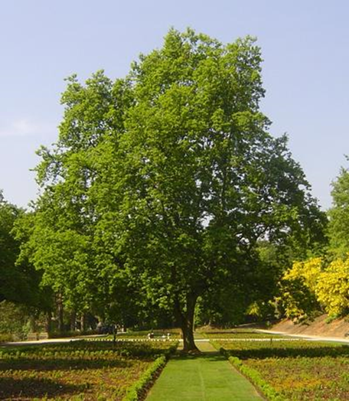
Arbitrariness of Language
árbol
شجرة
shū
Дерево
yugu
Baum
lignum
ağaç

Slide 7
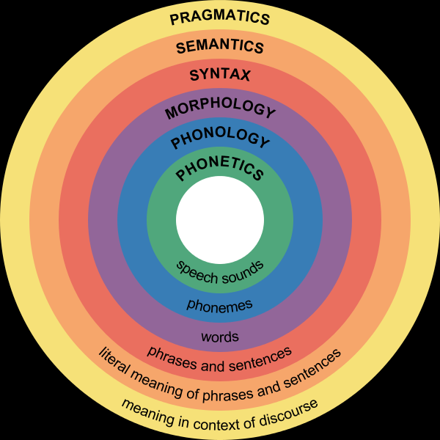
Linguistic hierarchy

Slide 8
Onto today’s topic...

Slide 9
Phonetics and Phonology
Phonetics
‘the study and classification of speech sounds’
Phonology
‘the study of relationships among the speech sounds of a language’

Slide 10
How do we produce speech sounds?
Majority of speech sound created by releasing air from the lungs through the mouth or nose
We use the stream of air, vocal chords and different configurations of the mouth
Two different types of sounds
Consonants – use the mouth to restrict the flow of air
Vowels – allow free flowing

Slide 11
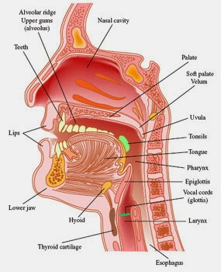
The vocal tract

Slide 12
Segue
For the rest of this hour, you need to suspend any notion you have that you may know how to spell
We’ll be spelling things exactly as they sound, using the International Phonetic Alphabet (IPA)
Hopefully you all have an IPA sheet to read from...

Slide 13
Consonants
Consonants can be formed in two ways
Air going out of the mouth (egressive)
Air being pulled into the mouth (ingressive)
The IPA sheet shows the full range of consonants that can be made in the human vocal tract.
There are clicks and ejectives as well, but we’ll leave those for another day, they can be treated in the same way as all other consonants

Slide 14
Consonants
Consonants are characterised in two ways:
Place of articulation – where we impede the flow of air
Was the air stopped by you teeth?
Did you make a sound by closing your pharynx?

Slide 15
Places of Articulation
Bilabial
Interdental
Palatal
Velar
Uvular
Glottal

Slide 16
Consonants
Consonants are characterised in two ways:
Place of articulation – where we impede the flow of air
Was the air stopped by you teeth?
Did you make a sound by closing your pharynx?
Manner of articulation – the way in which we impede the flow of air
Did you use your vocal chords?
Did you roll the sides of your tongue?
Did you stop the air completely? Or let it through, hissing?

Slide 17
Manner of Articulation
Does the air stop entirely in the mouth – its a stop
Have you lowered your velum – its a nasal
Have you almost stopped the flow of air – its a fricative
Do you tap the top of your tongue on the roof of your mouth – its a tap
Do you use the bottom of your tongue on the top of your mouth – its retroflex
Do you do something else entirely – its a sibilant, an affricate, an approximant

Slide 18
Some examples from English...
Stops – [p] [b] [t] [k]
Fricatives – [f] [v] [θ] [ð]
Sibilants – [s] [z]
Affricates – [ʧ] [ʤ]
Approximants – [w] [y]
Nasals – [n] [ŋ] [m]

Slide 19
Vowels
Vowels are made by engaging your vocal chords and shaping your vocal tract
Only a few ways to alter the sound of a vowel
Height of your tongue
‘Backness’ of your tongue
Rounding of your lips
Modifying the way your vocal chords vibrate

Slide 20
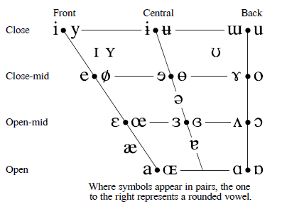
Vowels
Linguists can’t draw – this is meant to represent your mouth
Symbols in pairs – rounded on the right
Vowels combined together are called dipthongs

Slide 21
So all of this is nice...

Slide 22
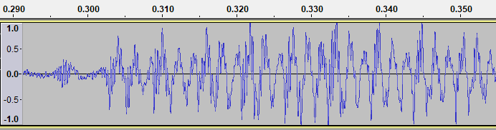
Speech waveform
Voice is a complex wave
Need to transform it using a Fourier Transform to make it more useful
We then view as a spectrogram which allows us to visualise time v frequency v amplitude

Slide 23
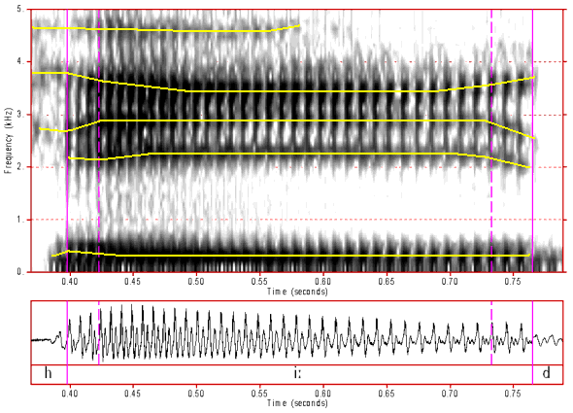
Spectrograms
Spectrogram (top) and Waveform (bottom) for the word ‘heed’ (/hiːd/)
On the left hand side of the spectrogram we can see the friction associated with producing an /h/
In the middle we see the vowel /iː/
On the right we see the stop /d/

Slide 24
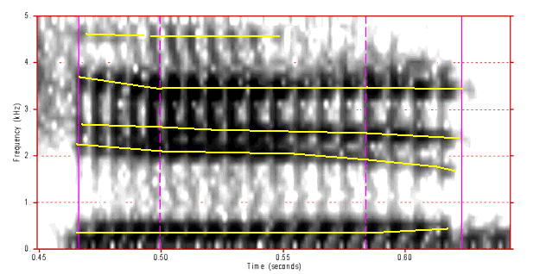
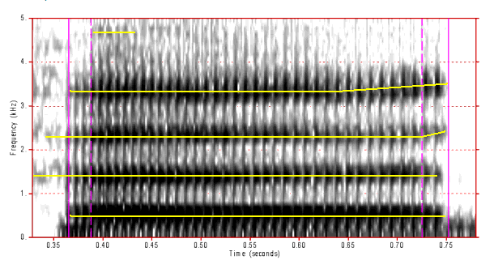
What can we see?
Two spectrograms – 1 vowel difference
Top word is ‘hid’ /hɪd/
Bottom word is ‘heard’ /hɛːd/

Slide 25
But how do we tell which vowel is which?
Taking measurements of F1 and F2 allows us to plot (approximately) the vowels on the vowel diagram we saw earlier
The higher the vowel, the lower F1
The smaller the difference between F1 and F2, the further back the vowel is

Slide 26
And the consonants...
Looking at the characteristics of the consonants allows us to determine what they are but they are slightly trickier
Voicing gives us a clue, along with the way the vowel slopes to meet the consonants
Won’t go into too much of this now as not everyone will be interested (but if you are come and chat to me and I can talk you through it)

Slide 27
So after that brief intro to articulatory phonetics...

Slide 28
Phonology
Phonology is the study of systems of sounds that make up a language
We introduced the full range of sounds that the human vocal tract can make for speech sounds in the previous section
But just because you can doesn’t mean you should...
Languages typically use a smaller set of the full number of sounds available
These sounds are called phonemes (loosely using this terminology, the definition often causes arguments amongst linguists)

Slide 29
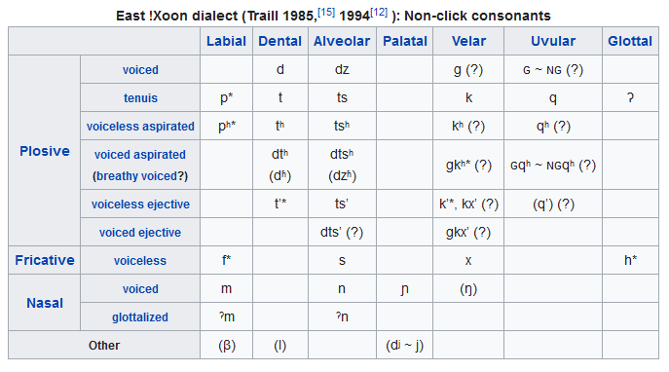
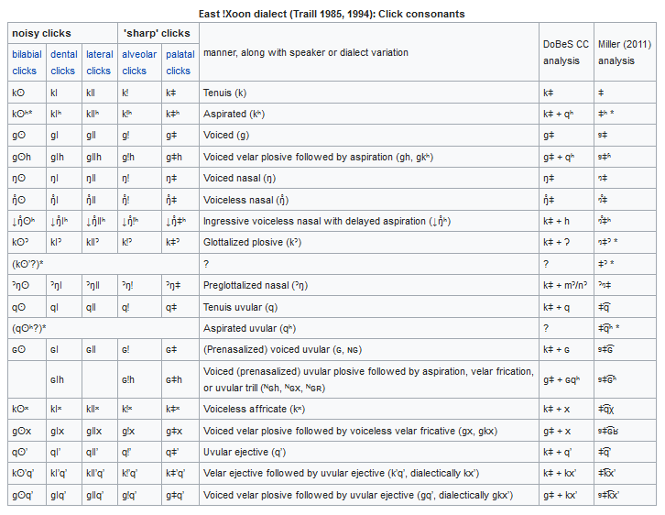
Maximal Phonology
Language with the most phonemes Taa (a Tuu language spoken in Botswana)
112 phonemes
All of these consonants plus 26 vowels

Slide 30

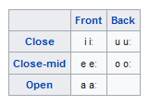
Minimal Phonology
And Rotokas, a North Bouganville language has the smallest number of phonemes
6 consonants
5 vowels (with length distinction)

Slide 31
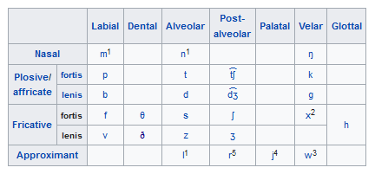
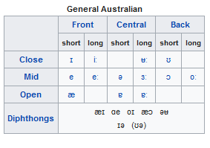
And how does Australian English compare?
44 phonemes
24 consonants
20 vowels

Slide 32
Some comments...
Phoneme inventories are often balanced
Voiced and voiceless pairs
Sets of places of articulation
Doesn’t mean we don’t find some weird stuff sometimes
Phoneme inventories and writing systems often don’t match well
We’ll deal with this problem in later sessions

Slide 33
But there’s more to phonology...
Phonology also encompasses the way speech sounds are strung together in words
Think about [t] in English
Can you think of different ways you can pronounce the sound [t]?

Slide 34
The [t] in English
The word table starts with the sound [t] but it’s aspirated
If you place your hand in front of your mouth as you say it, there’s a puff of air
The most informative way to write the IPA representation of the word is /tʰɛibl/
But there are rules in English that govern the way we use [t] so we only have to write [tɛibl]

Slide 35
The [t] in English
So at the start and ends of words in English we use an aspirated [t]
But what happens in the middle of words?
Some varieties of English use a tap instead of a /t/
Think of words like ‘butter’ and ‘letter’ when you say them quickly
Rather than saying /bʌtɐ/ some people tend to say /bʌɾɐ/

Slide 36

The [t] in English
So this allows us to set up series of rules for all of the sounds in a language (and also allows us to rule out some sounds as phonemes in their own right)
In English we have a rule that saysː
/t/ $→$ [ɾ] / V̠V
$→$[tʰ] / elsewhere
Although this is only one example, most English consonants have similar rules
And don’t get me started on the vowels...

Slide 37
And on to the more exciting stuff

Slide 38
Enter some ASR
Automatic Speech Recognition (ASR) is employed in a wide range of fields
Only giving a brief overview of some of the concepts, if there’s interest we can go into more depth later
We’ll build on some of the manual methods we’ve discussed

Slide 39

The basics of an ASR system...
Speech
Digitisation
Feature Extraction
Identifying Speakers
Comparison of feature vector to model
Construction of a feature vector
Identifying Languages
Speech-to-Text

Slide 40
Digitisation and Quantisation
Having already discussed a little of the speech bubble, let’s look at digitisation
Speech occurs in the range 0 – 20 000Hz
Most information in the human voice contained below 10 000 Hz, so no need to sample at 20 000Hz
Telephone networks only transmit signals below 4000Hz, so a sample rate of 8000Hz is sufficient for voices on telephones
Microphone speech generally requires 16 000Hz
Samples are then quantised in either an 8-bit or 16-bit format
Notes:
To accurately sample we must have two samples per cycle (Nyquist frequency)

Slide 41
Pre-emphasis and Windowing
Speech contains far more energy in lower frequencies
Boost higher frequencies to make maximal information available to the acoustic model (improves phone accuracy)
Statistical properties of speech are not stationary over time, need to extract spectral features from small, overlapping segments to allow subphone characterization
Usual configuration is to have a width of 25ms and an offset of 10ms

Slide 42
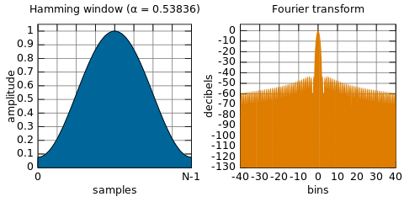
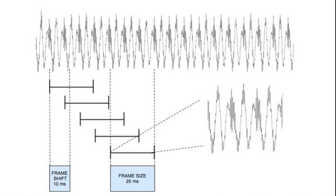
Windowing
Usually use a Hamming window to avoid discontinuities at window boundaries
Discontinuities cause problems with Fourier Transforms

Slide 43
Discrete Fourier Transform
Don’t worry I’m not going to go through the maths here...
The input is the quantised, windowed signal
The output is a complex number representing the magnitude and phase of that frequency component of the original signal

Slide 44

Mel Filter Bank
A ‘mel’ is a unit of pitch defined such that pairs of sounds which are perceptually equidistant in pitch are separated by an equal number of mels
In case you were wondering, it can be calculated using the following formula:
m = $1127 ln(1+\frac{f}{700}$)
Allows for the fact that human hearing is not equally sensitive at all frequencies
Modelling this property of human hearing during feature extraction improves speech recognition

Slide 45
Mel Filter Bank
By taking a number of linearly spaced filters below 1000 Hz and logarithmically spaced filters above 1000Hz
And then we measure the mel spectrum value and take the log of the value.
The log value makes the features less sensitive to variations due to things like power variations

Slide 46
Cepstrum
We now need a way to distinguish the source of the speech sound (the glottis) from the filter (the vocal tract)
We do this using the cepstrum
The cepstrum is the ‘spectrum of the log of the spectrum’
The resulting graphs show the elements that are associated with the fundamental frequency (F0) and those associated with articulators (various moving parts of the vocal tract)
Take the a number of these cepstral values – they have a useful property in that they are uncorrelated

Slide 47
Cepstral coefficients
From each frame we take the computed coefficients as well as the energy from the frame
As the speech signal is not constant from frame to frame, we also need to calculate velocity and acceleration for each of the cepstral coefficients
At the end we have a stack of MFCC features

Slide 48
i-Vectors
These MFCC features are then used to generate an i-vector
We use i-vectors under the assumption that any speech signal can be broken into a speaker independent portion and a set of speaker dependant features
Speaker dependant features are represented as a low dimension total variability matrix, where each i-vector controls an eigen-dimension of the matrix

Slide 49
i-vector extraction
After feature extraction we calculate 0th, 1st and 2nd order statistics over the values for the speaker
We iterate through a number of steps (estimating speaker factors, accumulating additional statistics, compute hyperparameters, compute covariances)
Left with i-vectors that characterise the speech

Slide 50
i-vector scoring
This bit is probably the easiest step
Calculate the cosine distance between the i-vectors and the models
Closest wins!!

Slide 51
Tying together the computation and the linguistics...

Slide 52
Thinking from the perspective of a language
We’re trying to capture the knowledge from the start of the slides in the statistics at the end
How many sounds does a language contain?
What’s their frequency?
What rules govern the way they can be put together?
Given enough data we can generate statistics that will provide an answer to all of these questions

Slide 53
Thinking about individuals
Different vocal tract dimensions – different frequencies
Different shaped/sized glottis – different frequencies
Different environmental conditions – different noise
What impact do colds and flus have? How about facial trauma?

Slide 54
Speech-to-text
If we know about the phonemes in a language, AND
We know about the probabilities of different patterns of phones, AND
We have a list of words (Lexicon)
We have the basis of a pretty good speech to text system (but we need a lot of data to model.....)

Slide 55
Next time...
We’ll take a look at morphology across a number of languages
We’ll look at how we might start developing lemmatization software
I’ll be much more enthusiastic because phonetics just isn’t my thing

Slide 56
Questions?
I understand that was pretty long but I would really like some questions and or feedback so that I know that I haven’t put you all to sleep!!

